Slide 1
Week 4 Recitation
BIOCHEM 5722
The one where this class becomes Calc II.

Slide 2
Objectives
Work through the recitation questions on Carmen.
Introduce concepts relevant to the practice problems.

Slide 3
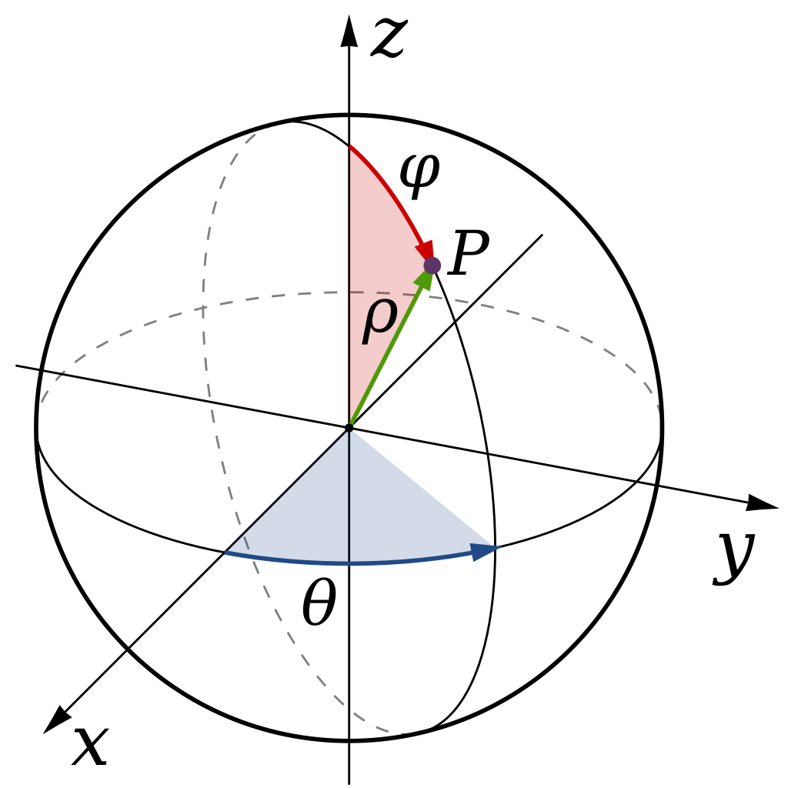
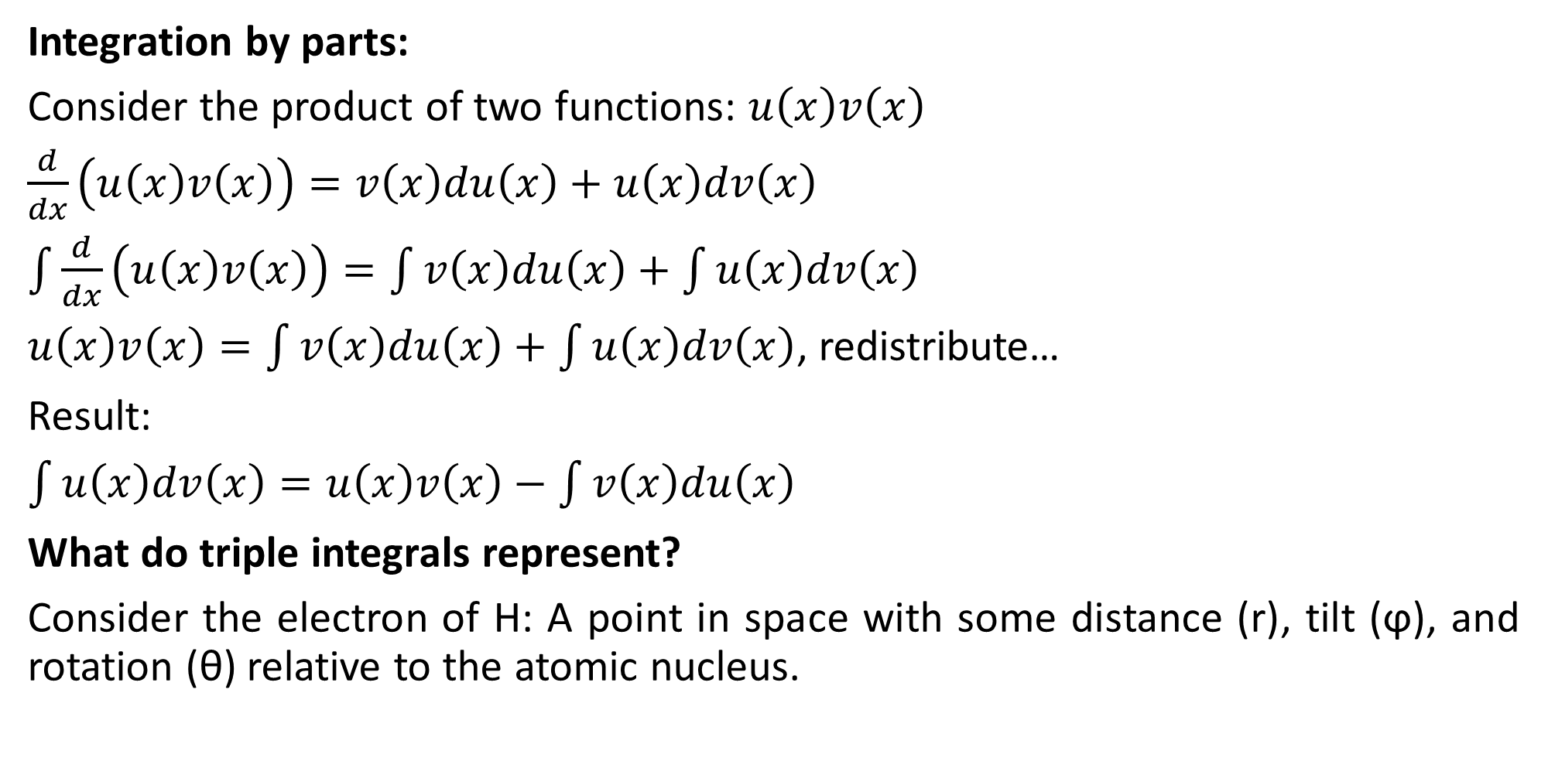
Integrals Galore
Integration by parts:
Consider the product of two functions: $u\left(x\right)v\left(x\right)$
$\frac{d}{dx}\left(u\left(x\right)v\left(x\right)\right)=v\left(x\right)du\left(x\right)+u\left(x\right)dv\left(x\right)$
$\int{\frac{d}{dx}\left(u\left(x\right)v\left(x\right)\right)=\int{v\left(x\right)du\left(x\right)+\int{u\left(x\right)dv\left(x\right)}}}$
$u\left(x\right)v\left(x\right)=\int{v\left(x\right)du\left(x\right)+\int{u\left(x\right)dv\left(x\right)}}$, redistribute…
Result:
$\int{u\left(x\right)dv\left(x\right)=u\left(x\right)v\left(x\right)−\int{v\left(x\right)du\left(x\right)}}$
What do triple integrals represent?
Consider the electron of H: A point in space with some distance (r), tilt (ϕ), and rotation (θ) relative to the atomic nucleus.

Slide 4
Questions?

Slide 5
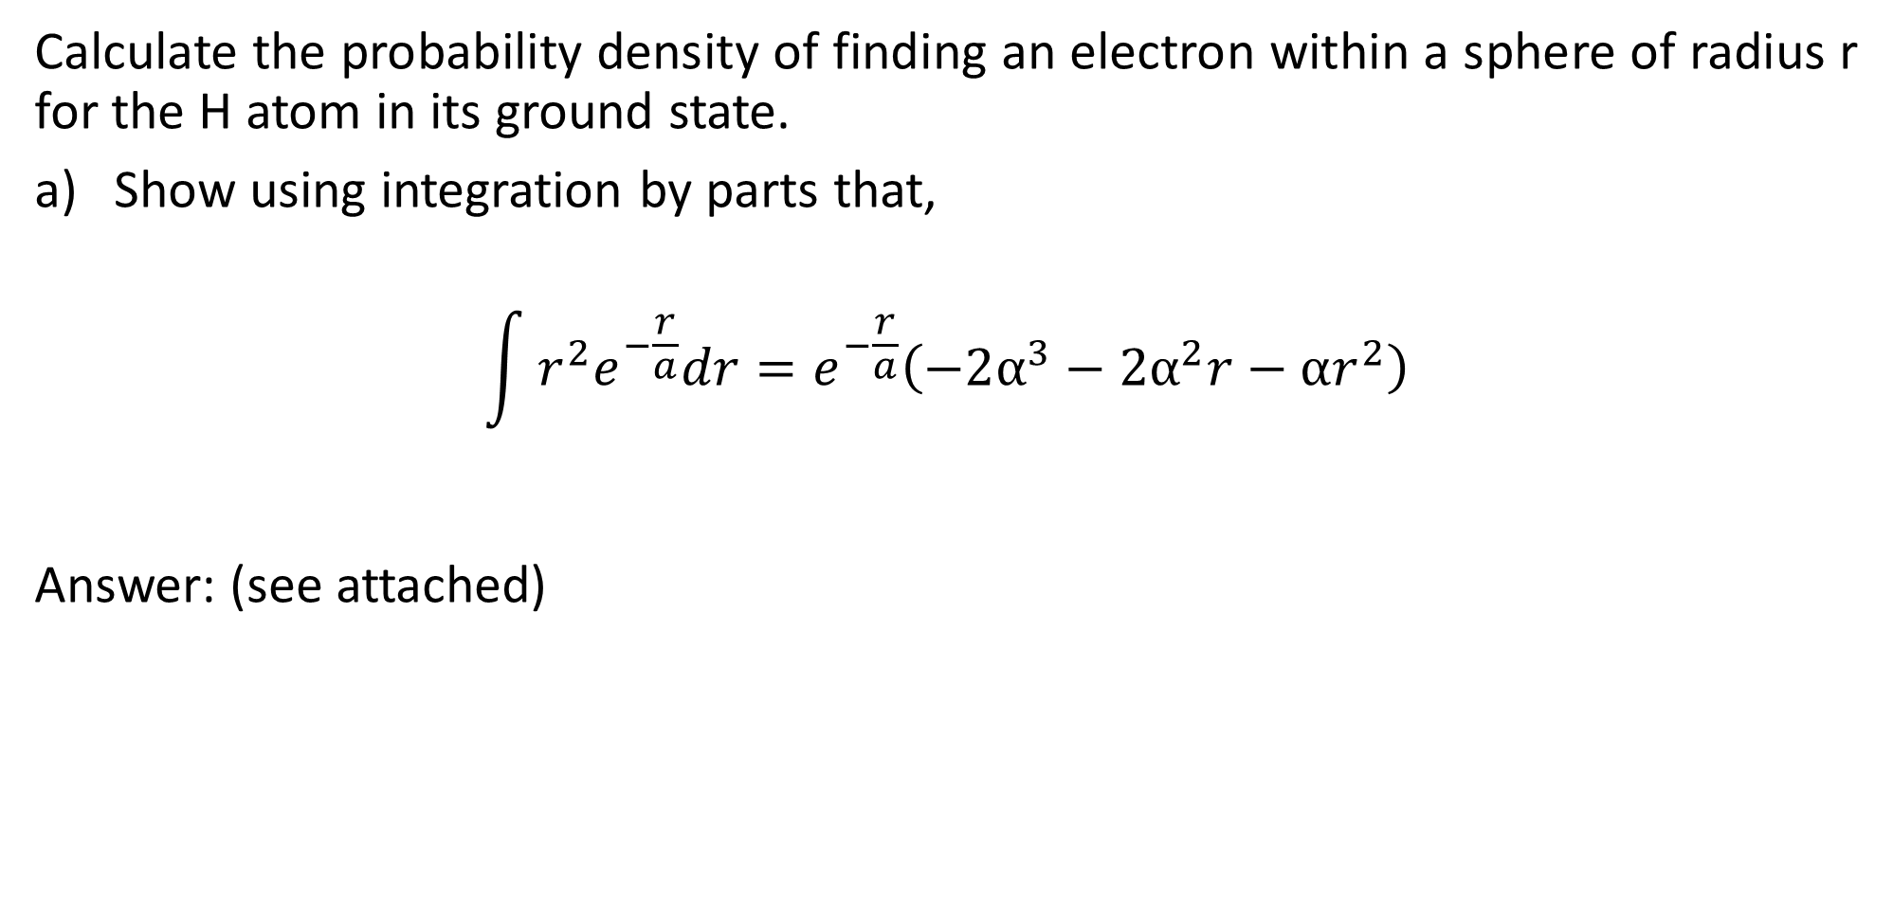
Q1
Calculate the probability density of finding an electron within a sphere of radius r for the H atom in its ground state.
Show using integration by parts that,
$$\int{r^{2}e^{−\frac{r}{a}}dr=e^{−\frac{r}{a}}\left(−2α^{3}−2α^{2}r−αr^{2}\right)}$$
Answer: (see attached)

Slide 6
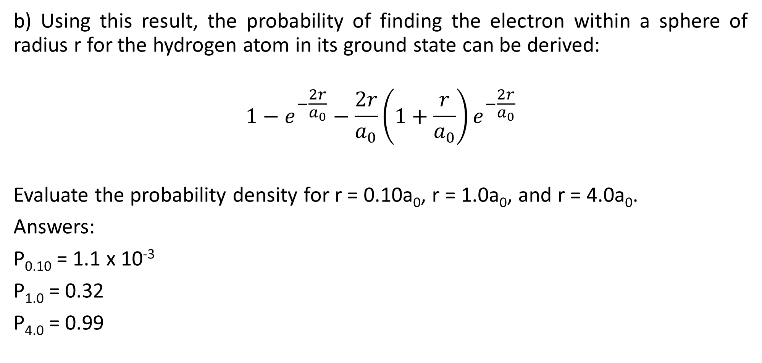
Q1 cont.
b) Using this result, the probability of finding the electron within a sphere of radius r for the hydrogen atom in its ground state can be derived:
$$1−e^{−\frac{2r}{a_{0}}}−\frac{2r}{a_{0}}\left(1+\frac{r}{a_{0}}\right)e^{−\frac{2r}{a_{0}}}$$
Evaluate the probability density for r = 0.10a₀, r = 1.0a₀, and r = 4.0a₀.
Answers:
P_{0.10} = 1.1 x 10⁻³
P_{1.0} = 0.32
P_{4.0} = 0.99

Slide 7
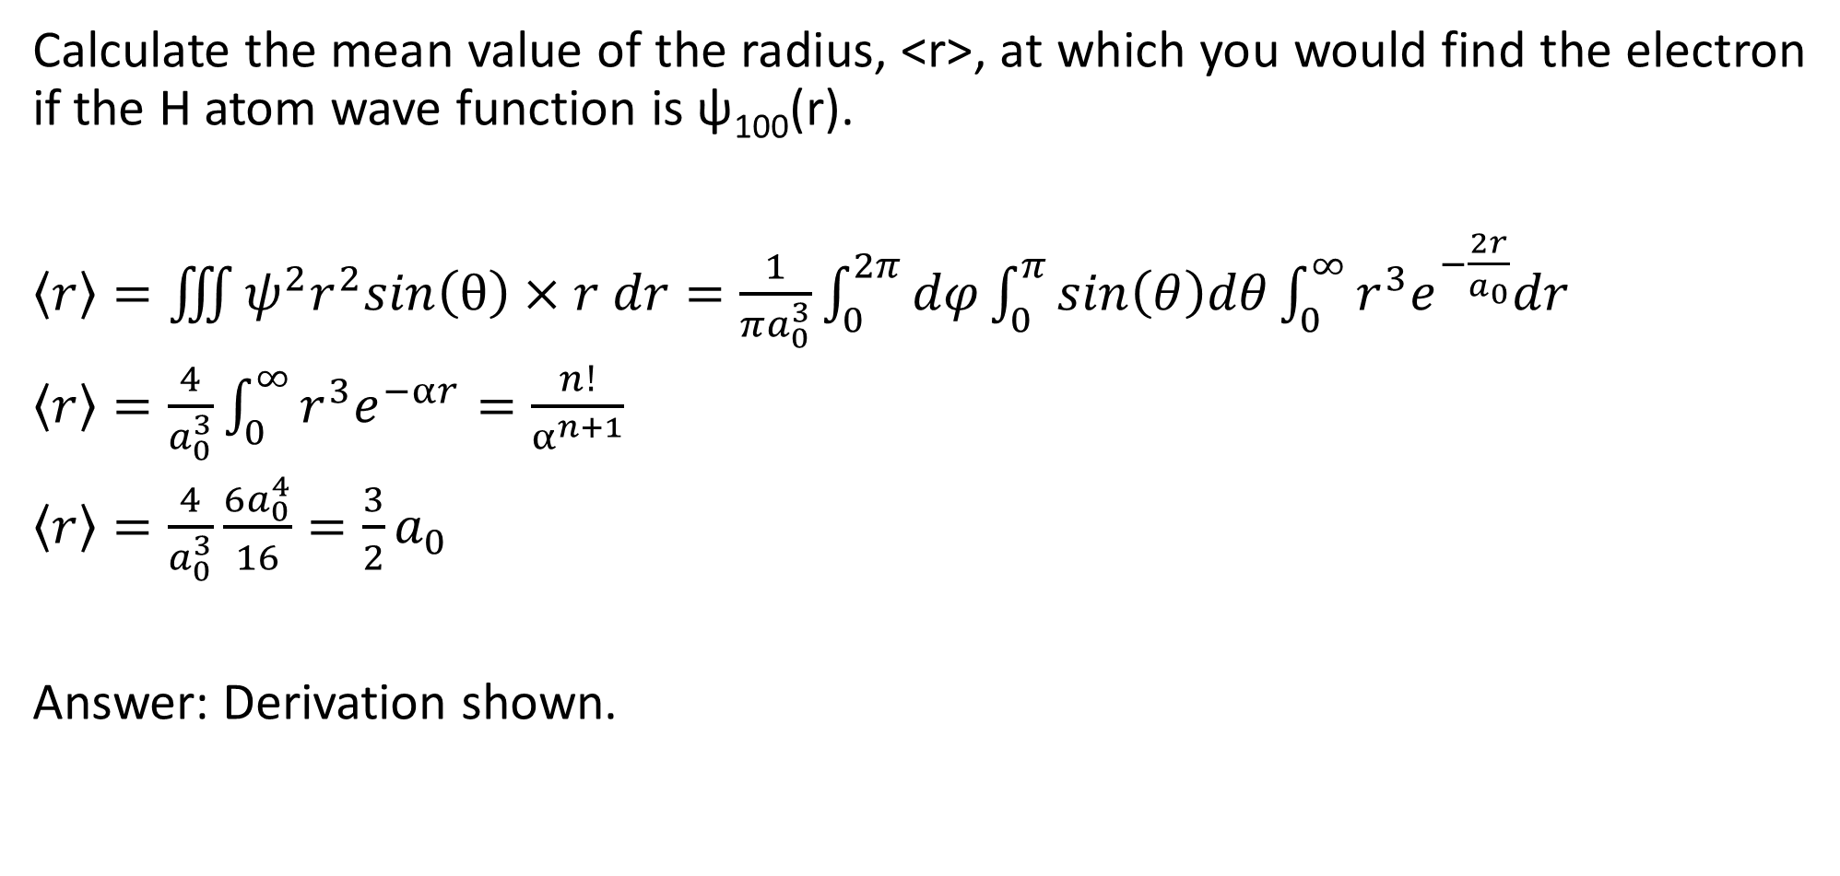
Q2
Calculate the mean value of the radius, <r>, at which you would find the electron if the H atom wave function is ψ₁₀₀(r).
$\left\langle r\right\rangle =\iiint{ψ^{2}r^{2}sin\left(θ\right)×r dr}=\frac{1}{πa_{0}^{3}}\int_{0}^{2π}{dφ}\int_{0}^{π}{sin\left(θ\right)dθ}\int_{0}^{∞}{r^{3}e^{−\frac{2r}{a_{0}}}dr}$
$\left\langle r\right\rangle =\frac{4}{a_{0}^{3}}\int_{0}^{∞}{r^{3}e^{−αr}}=\frac{n!}{α^{n+1}}$
$\left\langle r\right\rangle =\frac{4}{a_{0}^{3}}\frac{6a_{0}^{4}}{16}=\frac{3}{2}a_{0}$
Answer: Derivation shown.

Slide 8
Questions?
Have a good weekend!

